Slide 1

AI Systems for Visual Intelligence REVIEW – 2 Project Title
Team No - 14
Roll No Name
2320030424 – ALLAM SUBHASH
2320030228 – SHAHID NAWAZ
232003339 - SHAIKSHAVALI
Department of Computer Science and Engineering
KONERU LAKSHMAIAH EDUCATION FOUNDATION

Slide 2
OUTLINE
Abstract
Introduction
Existing System
Proposed System
Objectives
Software Requirements
Hardware Requirements
Functional Requirements
Non-Functional Requirements
Literature Survey
System Architecture
Module Design
Conclusion

Slide 3
Abstract
Big Data refers to extremely large datasets that cannot be processed efficiently using traditional data processing systems. These datasets are characterized by high volume, velocity, and variety. Customer support systems generate large amounts of textual data in the form of support tickets, making them suitable for Big Data analysis.
Customer Support Ticket Classification is the process of automatically categorizing customer support requests based on the content of the ticket. In organizations that receive thousands of support requests daily, manual classification becomes inefficient and time-consuming.
By using Big Data technologies such as Hadoop and Apache Spark, organizations can process large-scale customer ticket datasets efficiently. Natural Language Processing (NLP) techniques are used to analyze ticket text and extract useful information. Machine learning models are then trained on historical ticket data to automatically classify new tickets.
This automated approach helps organizations reduce manual effort, improve response time, and enhance customer satisfaction.

Slide 4
Introduction
Customer support is a critical part of any business organization. Companies receive customer queries through emails, chat systems, web forms, or helpdesk platforms. These queries are usually converted into support tickets that need to be handled by customer service teams.
As the number of customers increases, the volume of support tickets also grows significantly. Manual classification of these tickets into different categories is inefficient and prone to human errors. Therefore, an automated system is required to classify support tickets quickly and accurately.
Customer Support Ticket Classification uses Machine Learning and Natural Language Processing techniques to analyze ticket text and assign it to the correct category automatically. This system improves productivity, reduces operational costs, and ensures faster resolution of customer issues.

Slide 5
Existing System
In the traditional system, customer support tickets are handled manually by support agents or administrators. When a customer submits a ticket, the support team reads the ticket description and assigns it to the appropriate department.
Limitations of Existing System
Manual ticket categorization
Time-consuming process
Difficult to handle large volumes of tickets
High possibility of errors
Delayed customer response
Lack of scalability for large datasets
Traditional systems are not designed to handle large-scale data generated by modern customer support platforms.

Slide 6
Proposed Method
The proposed system uses Big Data technologies to automate the classification of customer support tickets.
Customer ticket data is collected and stored in distributed storage systems such as Hadoop Distributed File System (HDFS). The stored data is processed using Apache Spark, which enables fast and scalable data processing. Natural Language Processing techniques are used to preprocess ticket text and extract important features.
Machine learning algorithms are then used to train classification models that can identify patterns in customer queries. Once the model is trained, it can automatically classify new incoming tickets and route them to the appropriate support department.
Advantages of Proposed System
Handles large-scale datasets efficiently
Automated ticket classification
Faster processing using distributed computing
Reduced manual workload
Improved customer support efficiency
Scalable and reliable system

Slide 7
OBJECTIVES
The objectives of the proposed system include the following:
To collect and store large volumes of customer support ticket data.
To process large-scale ticket data using Big Data technologies.
To apply Natural Language Processing techniques for text analysis.
To build machine learning models for ticket classification.
To improve the efficiency of customer support systems.
To reduce manual effort in ticket management.

Slide 8
SOFTWARE REQUIREMENTS
The following software tools are required for the development of the system:
Python
Hadoop
Apache Spark
Apache Hive
Python IDE (VS Code / Jupyter Notebook)
GitHub
NLP Libraries (NLTK / SpaCy)
Scikit-learn
Flask or Streamlit (for deployment)

Slide 9
HARDWARE REQUIREMENTS
The hardware requirements for the system include:
Processor – Intel i3 or higher
RAM – 8 GB or higher
Storage – 50 GB or higher
Operating System – Windows / Linux
Distributed computing environment (optional cluster)

Slide 10
FUNCTIONAL REQUIREMENTS
The system should collect customer support ticket data.
The system should store data using distributed storage systems.
The system should preprocess text data using NLP techniques.
The system should train machine learning models.
The system should classify new support tickets automatically.
The system should route tickets to the appropriate department.

Slide 11
NON-FUNCTIONAL REQUIREMENTS
Reliability
The system should consistently provide accurate classification results.
Security
Access to the system should be restricted to authorized users.
Scalability
The system should be able to process increasing volumes of customer ticket data.
Performance
The system should provide fast processing and classification of support tickets.

Slide 12
Literature Survey
Name of the research paper | Author name | Technologies used | Advantages/ Disadvantages | Links
AI-based Classification of Customer Support Tickets: State of the Art and Implementation with AutoML | Mario Truss, Stephan Böhm | AutoML, Machine Learning, NLP | Advantage: Automates ticket classification and improves accuracy. Disadvantage: Requires large labeled datasets. | https://arxiv.org/abs/2406.01789
Machine Learning for Classification of IT Support Tickets | Leonardo S. B. Pereira et al. | Neural Networks, Python, TensorFlow | Advantage: Improves ticket routing efficiency. Disadvantage: Model training requires high computational resources. | https://www.researchgate.net/publication/368906495_Machine_Learning_for_Classification_of_IT_Support_Tickets
Classifying Unstructured IT Service Desk Tickets Using Ensemble Classifiers | Ramya C., Paramesh S.P., Shreedhara K.S. | Ensemble Learning, Machine Learning | Advantage: Improves classification accuracy using multiple models. Disadvantage: Model complexity increases. | https://arxiv.org/abs/2103.15822

Slide 13
Literature Survey
Name of the research paper | Author name | Technologies used | Advantages/ Disadvantages | Links
Spark NLP: Natural Language Understanding at Scale | Veysel Kocaman, David Talby | Apache Spark, Big Data, NLP | Advantage: Enables scalable processing of large text datasets. Disadvantage: Requires distributed infrastructure | https://arxiv.org/pdf/2101.10848
Automatic Ticket Assignment Using Machine Learning | Sejal Shah | Machine Learning, NLP | Advantage: Reduces manual ticket routing effort. Disadvantage: Accuracy depends on training data quality. | https://norma.ncirl.ie/4416/1/sejalshah.pdf

Slide 14
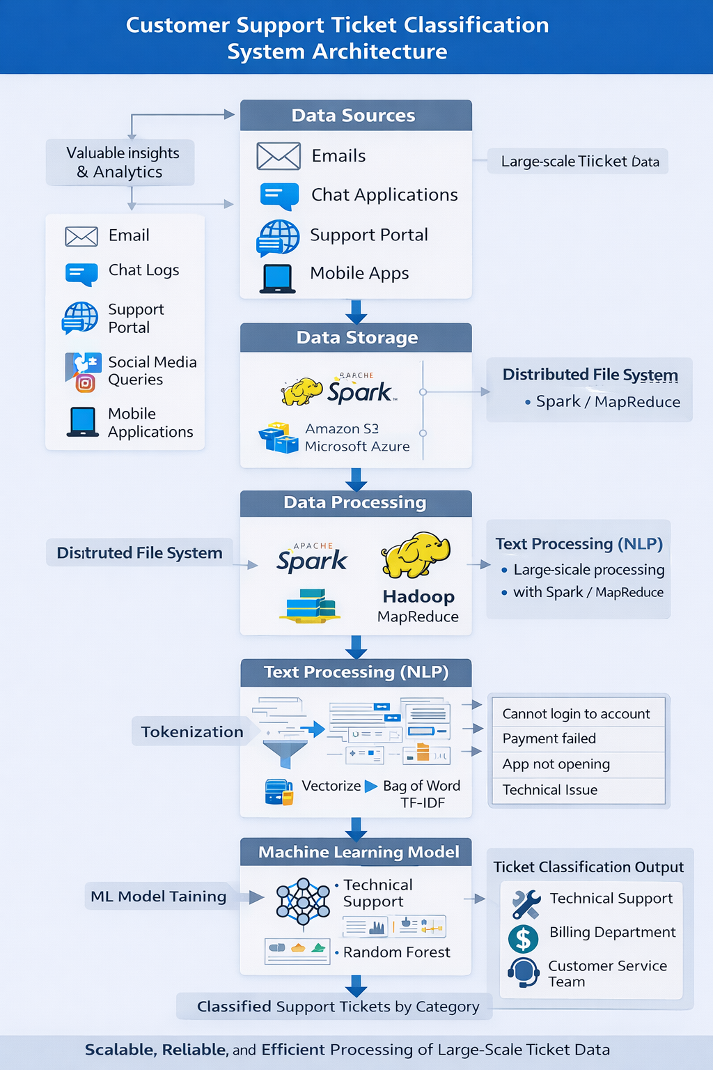

Slide 15
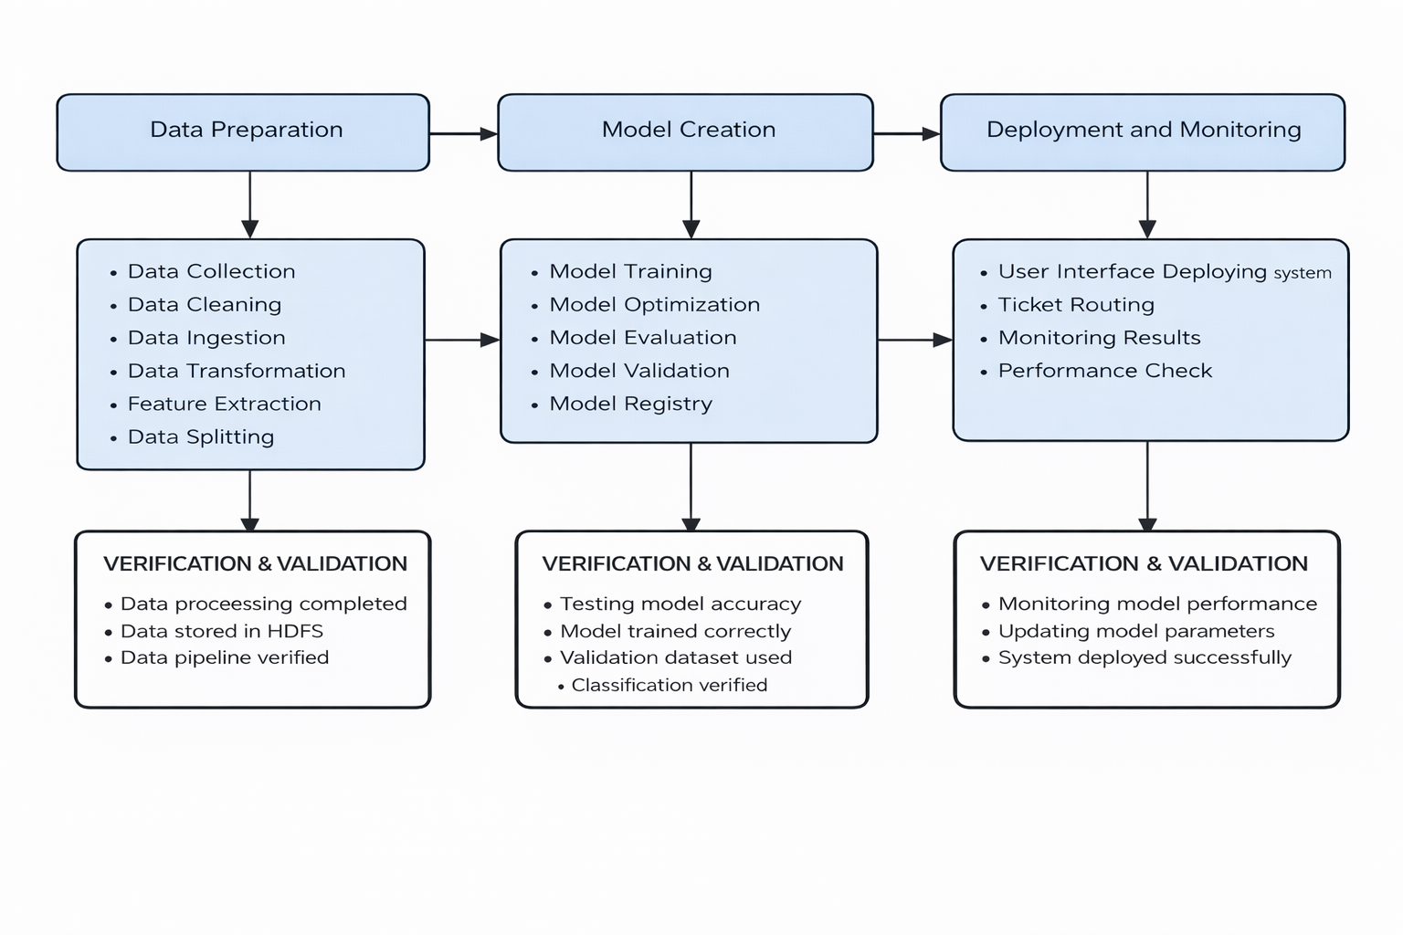
Module Design

Slide 16
Conclusion
This project proposes an automated system for classifying customer support tickets using machine learning and NLP techniques.
The system will help organizations:
Reduce manual ticket sorting
Improve response time
Increase customer satisfaction
Future Work
Implement deep learning models.
Add priority detection
Integrate with real-time helpdesk platforms

Slide 17
THANK YOU

